Slide 1
Blockchain Analysis (April 2019) Presentation
Daniel Byrne, Benjamin Wilke, Brian Coari, YuMei Bennett
DS7349 – Section 404

Slide 2
Project analysis slide 2
Blockchain Introduction
Developed in 2008 by Satoshi Nakamoto (pseudonym, real identity unknown) for use with cryptocurrency, but can be anywhere that trust, privacy, resilience and security are necessities.
Blockchain is an unchangeable transaction log, aka digital ledger
Blockchain is decentralized and public, relying on a community to ensure trust and accountability
There are many types of blockchains (public, private, and federated)

Slide 3
Project analysis slide 2
History of Blockchain
DES was developed in the early 1970s by IBM and Modified by NSA to make it crackable.
Academics Balked and Public / Private Key Encryption soon Emerged.
“Cypherpunks”, a technical community focused on privacy and rebellion against controlling authorities.
Blockchain arose from research and communication in this group.
The technology for Blockchain was based on the concept of “Blind Signatures” by David Chaum, which provided accountability without compromising privacy but still relied on a third-party approver., such as a bank . ^{[3]}
Blockchain also borrowed concepts from Hal Finney’s “Reusable Proofs of Work (RPOW)”, which required systems slow themselves down in order to increase the cost of an attack. ^{[4]Encryption Sta}

Slide 4
Blockchain was based on the concept of “Blind Signatures” by David Chaum,
Provided accountability but relied on a third-party approver., such as a bank . ^{[3]}
Blockchain also borrowed concepts from Hal Finney’s “Reusable Proofs of Work (RPOW)”,
Required systems slow themselves down to increase cost of an attack. ^{[4]Encryption Sta}

Slide 5
Project analysis slide 2
The Birth of Blockchain
Using the tenants of the Cypherpunks and the technology around Blind Signatures and RPOW, along with a general mistrust of central authorities approving transactions, Blockchain was born.
The originally proposal for Blockchain was in a 2008 paper by Satoshi Nakamoto and was intended for a cryptocurrency called Bitcoin, but generically could be used for any digital transaction.
Bitcoin was not the first cryptocurrency, but it was the first cryptocurrency to establish trust and accountability without a central authority, making Blockchain a huge leap forward in cyber security.

Slide 6
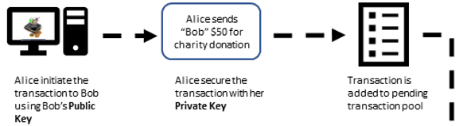
Project analysis slide 2
Blockchain Walkthrough Pt 1
First a Blockchain transaction is created and asymmetrically encrypted
Then the transaction is added to a transaction pool for validation

Slide 7
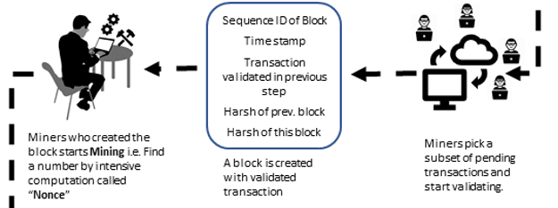
Project analysis slide 2
Blockchain Walkthrough Pt 2
The transaction is then verified by the decentralized community of “miners”
The validated transaction is stored in a block
The miner that validated the transaction creates a “nonce”, the proof-of-work that can be used to validate the transaction.

Slide 8
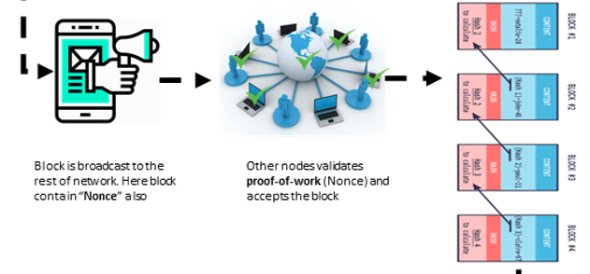
Project analysis slide 2
Blockchain Walkthrough Pt 3
The black and nonce are verified by the community and, if valid, added to the community’s distributed ledger.

Slide 9
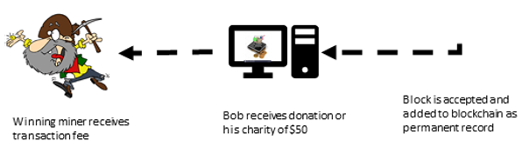
Project analysis slide 2
Blockchain Walkthrough Pt 4
The recipient receives the result of the transaction (in this case, $50 for a charity)
The Miner that validated the block and generated the nonce receives a transaction fee.

Slide 10
Project analysis slide 2
BigChainDB
For our demo we will show an implementation of a Blockchain Database called BigchainDB.
BigchainDB Features:
Decentralized Control
Network of peer nodes ensure trust and accountability
Transaction Immutability
Transactions cannot be changed after they are committed to the decentralized network
Standard Queries
MongoDB query engine to access stored transaction and asset data
Fast Commits
Ranges from a few milliseconds to a few seconds to enable use in fast-paced areas, such as stock trading.
Sybil Tolerance
Minimizes false nodes (Sybils) on a network using a governing authority to approve all requests.

Slide 11
Project analysis slide 2
BigChainDB Demo
In this tutorial we cover:
Creating User Identities
Creating Digital Assets
Assigning ownership to assets through a transaction
Transferring assets between two identities
Querying the blockchain for a record of these transactions

Slide 12
BigchainDB Demo

Slide 13
References pt 1
Judd Bagley (2018 , Sep . ). What is Blockchain Technology? A Step-by-Step Guide For Beginners. Blockgeeks. [Online]. Available: https://blockgeeks.com/guides/what-is-blockchain-technology/
http://en.citizendium.org/wiki/Cypherpunk/Citable_Version “Cypherpunk/Citable Version”
David Chaum (1982). Blind Signatures for Untraceable Payments [Online]. Retrieved on Feb 10, 2019 Available: http://www.hit.bme.hu/~buttyan/courses/BMEVIHIM219/2009/Chaum.BlindSigForPayment.1982.PDF
Aaron van Wirdum (April 2018). The Genesis Files: How David Chaum’s eCash Spawned a Cypherpunk Dream [Online]. Retrieved on Feb 10, 2019 Available: https://bitcoinmagazine.com/articles/genesis-files-how-david-chaums-ecash-spawned-cypherpunk-dream/
Hal Finney (August 2004) Reusable Proofs of Work [Online]. Retrieved on Feb 10, 2019 Available: https://web.archive.org/web/20071222072154/http://rpow.net/

Slide 14
References pt 2
https://www.bigchaindb.com/developers/guide/key-concepts-of-bigchaindb/ "Key concepts of BigchainDB“

Slide 15
Thank You

